Slide 1
Connectionist Computing
COMP 30230/41390
Gianluca Pollastri
office: CASL, ground floor Science East.
email: gianluca.pollastri@ucd.ie
Connectionist Computing COMP 30230

Slide 2



Credits
Geoffrey Hinton, University of Toronto.
  borrowed some of his slides for “Neural Networks” and “Computation in Neural Networks” courses.
Ronan Reilly, NUI Maynooth.
  slides from his CS4018.
Paolo Frasconi, University of Florence.
  slides from tutorial on Machine Learning for structured domains.
Connectionist Computing COMP 30230

Slide 3
Lecture notes on Moodle
https://csmoodle.ucd.ie/moodle/course/view.php?id=288
Strictly confidential...
Enrolment key: 30230cc
Connectionist Computing COMP 30230

Slide 4
Books
No book covers large fractions of this course.
Parts of chapters 4, 6, (7), 13 of Tom Mitchell’s “Machine Learning”
Parts of chapter V of Mackay’s “Information Theory, Inference, and Learning Algorithms”, available online at:
http://www.inference.phy.cam.ac.uk/mackay/itprnn/book.html
Chapter 20 of Russell and Norvig’s “Artificial Intelligence: A Modern Approach”, also available at:
http://aima.cs.berkeley.edu/newchap20.pdf
More materials later..
Connectionist Computing COMP 30230

Slide 5
Marking
3 landmark papers to read, and submit a 10-line summary on Moodle about: each worth 6.67%
a small connectionist tool to build and play with: 30%
Final exam: 50%
Connectionist Computing COMP 30230

Slide 6
Programming assignment
Implement a Multi-Layer Perceptron, test it.
The description on Moodle.
Submit through Moodle code and test results by April the 28th at 23:59, any time zone of your choice (Baker Island?).
30% of the overall mark
One third of a grade down every day late, that is: if you deserve an A and you’re 1 day late you get an A-, 2 days late a B+, etc.
Connectionist Computing COMP 30230

Slide 7
Assignment 3
Read the paper “Reducing the Dimensionality of Data with Neural Networks”, by Hinton and Salakhutdinov (2006).
Don’t panic!
The paper is on Moodle.
Submit through Moodle a 400 word MAX summary by April 18th at 23:59, any time zone of your choice (Baker Island?).
6.67% of the overall mark.
One third of a grade down every day late, that is: if you deserve an A and you’re 1 day late you get an A-, 2 days late a B+, etc.
Connectionist Computing COMP 30230

Slide 8
Models, data and Bayes
P(M|D) = P(D|M)P(M)/P(D)
P(M) is our estimate that model M is correct before seeing D.
P(M|D) is our estimate that M is correct after having looked at D.
P(D|M) is generally called likelihood.
Connectionist Computing COMP 30230

Slide 9
Using the Bayesian machinery
We can try to select the model that minimises the following error:
E = - logP(M|D) = -log P(D|M) - log P(M) + log P(D)
This is called MAP (maximum a posteriori) estimate, because we are maximising the posterior.
Connectionist Computing COMP 30230

Slide 10
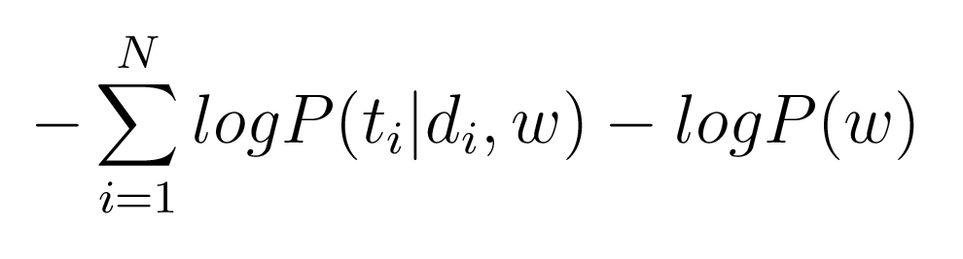
MAP/ML, NNs and supervised learning
The terms expressing the probability of the inputs don’t depend on the weights of the model.
What we are interested in minimising is:
Connectionist Computing COMP 30230

Slide 11
The prior
If we assume that P(w) has a Gaussian distribution, -log P(w) contributes a term proportional to –w² to the error. This is precisely weight decay.
Weight sharing can also be included into the prior.
Connectionist Computing COMP 30230

Slide 12
The likelihood: linear case
Let’s assume that we have a MLP with linear output.
We want to evaluate P(t|d,w). It is natural to express (d,w) as what the model does with d, i.e. the output of the model to d: y(d)=y. We can rewrite:
P(t|d,w) = P(t|y)
Connectionist Computing COMP 30230

Slide 13
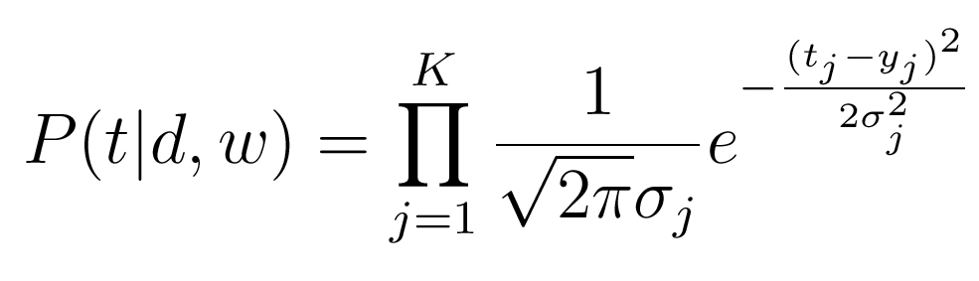
Linear output: Gaussian assumption
The “natural” distribution of t given y in the linear case is Gaussian.
Connectionist Computing COMP 30230

Slide 14
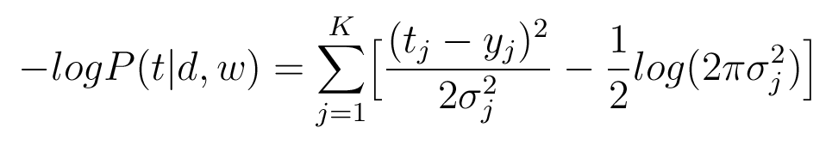
Error for Gaussian assumption
If we assume that the target is distributed like a gaussian variable with mean y, then the log likelihood becomes:
Connectionist Computing COMP 30230

Slide 15
Natural assumptions
For the linear output case (regression), if we assume that P(t|y) is distributed like a Gaussian, the associated likelihood really looks just like a squared error.
This means that minimising the squared error really means doing ML.
[And if we add a bit of weight decay we can call it MAP]
Connectionist Computing COMP 30230

Slide 16
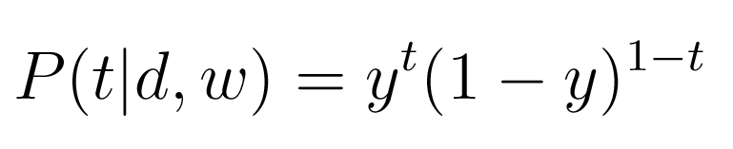
The likelihood: binary classification
In this case we have two classes and we want to assign each example to either.
We can use a binomial model for P(t|d,w):
This also implies that y(d) is an estimate of the probability that d is in either class (also: y must be in [0,1]).
Connectionist Computing COMP 30230

Slide 17
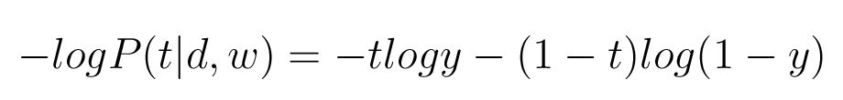
Error for binary classification
In this case, the log likelihood becomes the relative (mutual) entropy between target and output:
Connectionist Computing COMP 30230

Slide 18
Natural assumptions 2
For the binary classification case, if we assume that P(t|y) is distributed binomially, the associated likelihood really looks just like a relative (mutual) entropy error.
If we implement the output using a sigmoid, taking the derivative of the error wrt the weights the only output term remaining is proportional to (t-y).
Connectionist Computing COMP 30230

Slide 19
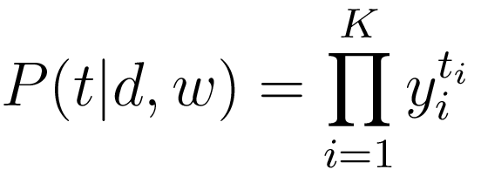
Multinomial case
In the more general case of multi-class classification we can assume a multinomial model for the likelihood:
This also implies that y(d) estimates the probability of d being in any class (also: yi must sum to 1).
Connectionist Computing COMP 30230

Slide 20
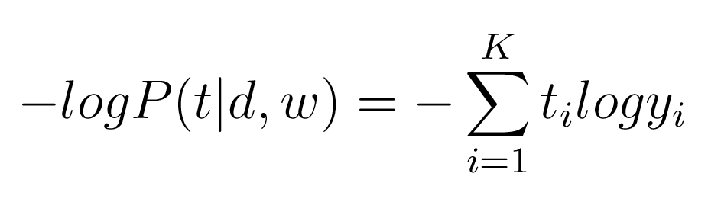
Error in the multinomial case
In this case the log-likelihood becomes:
This is again a relative (cross) entropy.
Connectionist Computing COMP 30230

Slide 21
Natural assumptions 3
For the multi-class classification case, if we assume that P(t|y) is distributed multinomially, the associated likelihood really looks just like a relative (cross) entropy error.
We saw before that if we implement the output using softmax, taking the derivative of the error wrt the weights the only output term remaining is proportional to (t-y).
Connectionist Computing COMP 30230

Slide 22
Deep networks
and Deep Learning
Connectionist Computing COMP 30230

Slide 23
Deep networks?
output
code
input vector

Slide 24
Deep is hard
There are many reasons why deep should work better than shallow.
But anyone who has trained a neural network with many layers knows the more inner layers you add, the longer the initial plateau lasts.
By 5 hidden layers, typically, it is long enough that you can't afford to wait..

Slide 25
Deep is hard because gradients vanish
The problem is that when networks get deep the gradient vanishes.
When a network is untrained, the deeper down a hidden unit is, the more subtle its effect is on the outputs.
If it's subtle, it means it doesn't do much to the error if you change it.
Connectionist Computing COMP 30230

Slide 26
Old solutions
Several solutions, often ad hoc, over the years.
Typically they involved tampering with the gradient in a way or another:
The gradient is vanishing? Don't let it..

Slide 27
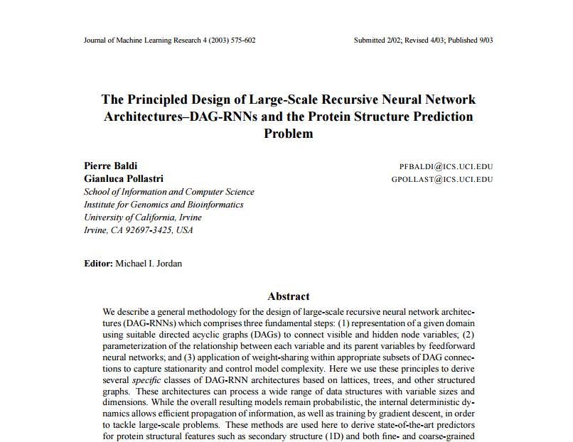

Slide 28
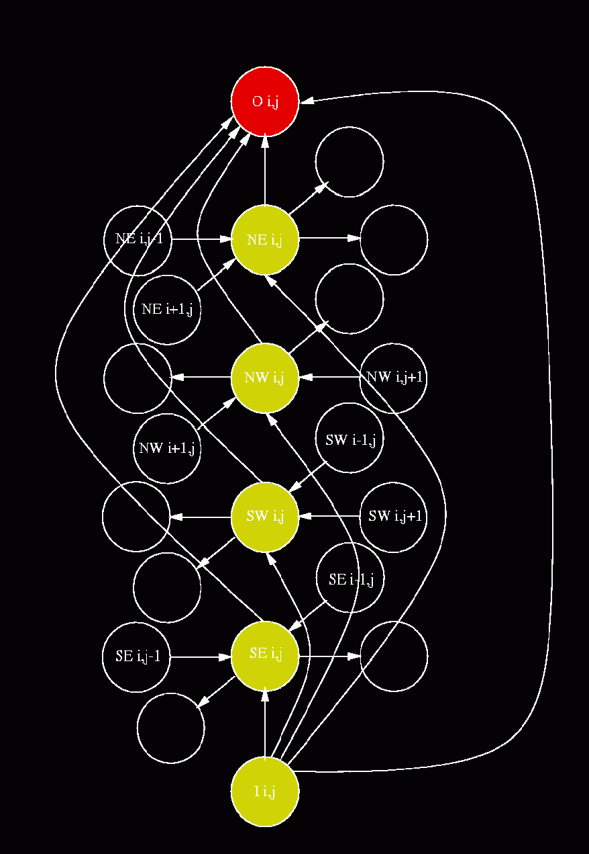
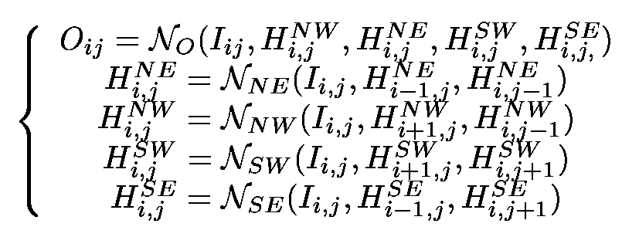
2D RNNs
Pollastri & Baldi 2002, Bioinformatics
Baldi & Pollastri 2003, JMLR

Slide 29
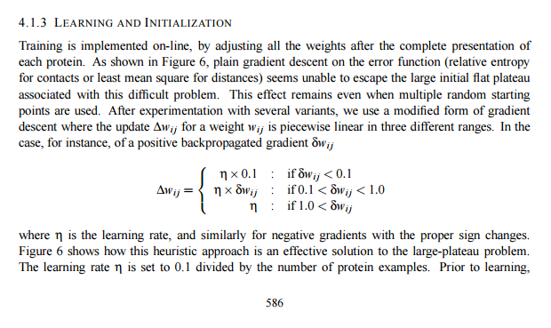

Slide 30
Deep learning solutions
These are more principled solutions that were proposed starting circa 2006.
Essentially they fall into two main categories:
pre-train
use artificial inner targets
Connectionist Computing COMP 30230

Slide 31
The rationale of pre-training
Stack deep networks layer by layer.
Make sure your first hidden layer represents the input meaningfully before you add a second layer.
Then make sure your second layer represents the first layer (thus, the input) meaningfully before you add a third layer.
And so on…
This can be done by auto-association
Connectionist Computing COMP 30230

Slide 32
Pre-training
output
code
input vector

Slide 33
Pre-training (2)
input vector
code 1
input vector

Slide 34
Pre-training (3)
code 1
code 2
code 1
input vector

Slide 35
Pre-training (4)
code 2
code 3
code 2
code 1
input vector

Slide 36
Pre-training (end)
output
code 3
code 2
code 1
input vector

Slide 37
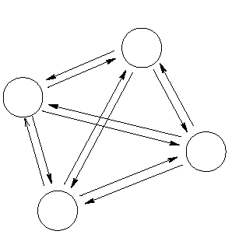
Boltzmann Machines
Networks of stochastic units.
Feedback networks: each units has connections to all other units except itself.

Slide 38
Yes, but what the heck are they for?
The idea is training this thing so that we place minima where we want them..
We have a bunch of examples, we tweak the weight matrix by some rule, and at the end of our tweaking the machine will have a penchant for falling into the examples when we let it run.

Slide 39
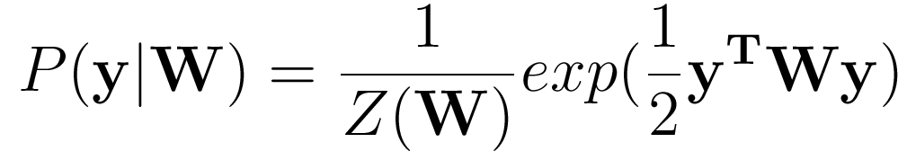
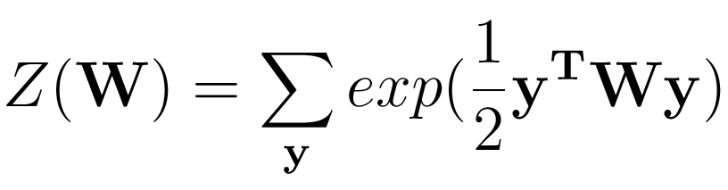
Implementing a probability distribution
It can be shown that the Boltzmann machine generates configurations according to the distribution:
Where:
weight matrix
State of neurons
Connectionist Computing COMP 30230

Slide 40
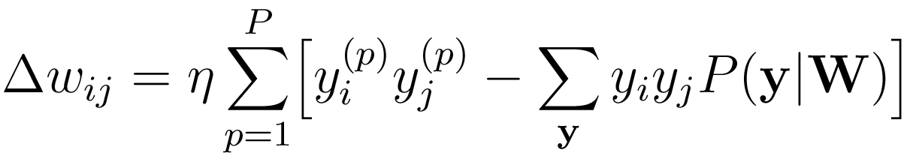
Learning in the Boltzmann machine
Working on the probability distribution one gets the following learning rule:

Slide 41
Learning in the Boltzmann machine
The first term is fine (quick and always the same).
The second term is a bummer..
Monte Carlo: estimate it by letting the machine run an awful lot of times.
(and you have to repeat this for every epoch)

Slide 42
Hidden units for Boltzmann machines
Hidden units.
Instead of using the net just to store memories, use it to construct interpretations of the input.
  The input is represented by the visible units.
  The interpretation is represented by the states of the hidden units.
Visible units.

Slide 43
Restricted Boltzmann Machines (RBM)
We restrict the connectivity to make inference and learning easier.
  Only one layer of hidden units.
  No connections between hidden units.
If it works, the hidden units are a perfect code for the examples!
j
hidden
visible
i

Slide 44
Alternative pre-training: Restricted Boltzmann Machines
code 1
input vector

Slide 45
RBM pre-training (2)
code 2
code 1
input vector

Slide 46
RBM pre-training (3)
This is what they call a
Deep Belief Network
code 3
code 2
code 1
input vector

Slide 47
RMB (end)
output
Notice: recast in
neural net fashion:
unidirectional
arrows!
code 3
code 2
code 1
input vector

Slide 48
About pre-training by auto-association
(Massive) advantage:
  you can use unlabelled data!
(Potentially disastrous) disadvantage:
  you aren't considering at all the property you want to predict
  you compress regardless of the property. If it's lossy, the loss can be in the wrong place..

Slide 49
Pre-training without auto-association
output
code 3
code 2
code 1
input vector

Slide 50
Pre-training without auto-association (2)
output
code 1
input vector

Slide 51
Pre-training without auto-association (3)
output
code 2
code 1
input vector

Slide 52
Pre-training without auto-association (4)
output
code 3
code 2
code 1
input vector

Slide 53
About pre-training without auto-association
(Possibly big) disadvantage:
  you can't use unlabelled data! You need a target at all stages.
  that said, less data = shorter training
(Possibly big) advantage:
  you compress based on the property you are trying to predict. If it's lossy, the loss is probably in the right place..

Slide 54
Deep learning: artificial targets
The real problem is that inner layers don't get gradient.
Every now and then use hard targets:
  generate a handful of random targets for the layer
  check them all (how do they fare on this example?)
  Use the best one..

